Slide 1


Prepared by Group 12
Critical Design Review
SMARTNAV CANE: A Sensor-Integrated Mobility Aid for Enhanced Navigation
June 6, 2025

Slide 2




Team Members
Evans Bakire
Brennan Russell
Sharifah Alselahi
Computer Engineering
Electrical Engineering
Computer Engineering
Deon McCoy
Yussef Abdelbary
Electrical Engineering
Computer Engineering

Slide 3
Introduction
As part of our Senior Design project, my team and I set out to create a meaningful and practical solution to help individuals with visual impairments navigate the world more safely and independently. Our project, the SmartNav Cane, is a smart mobility aid that combines sensor technology, GPS navigation, and intuitive user feedback in the form of audio and vibration cues. The idea was driven by both technical curiosity and personal motivation—several of us have family members with visual impairments, and we’ve seen firsthand the daily challenges they face when it comes to mobility.

Slide 4
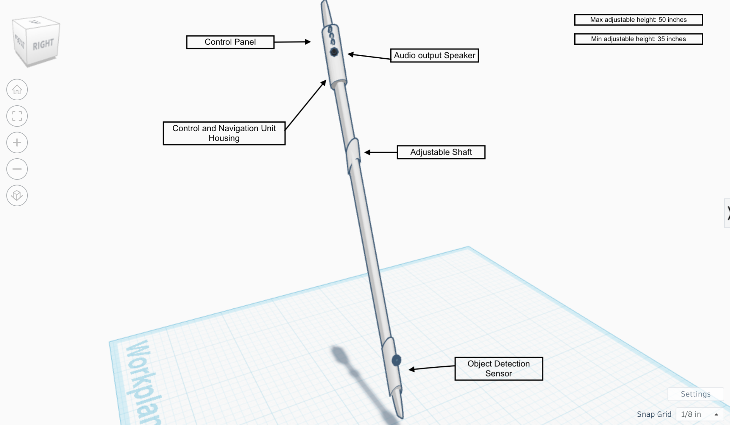
Motivation and Background
Traditional white canes have remained mostly unchanged and don’t offer smart features like obstacle detection or navigation assistance.
Many visually impaired individuals still struggle with safely navigating busy or unfamiliar environments.
Several of our group members have family members who are visually impaired, which gave us a personal drive to work on a solution that actually matters.
We researched existing solutions like the WeWALK Smart Cane and Sunu Band.
While innovative, they have limitations like short-range detection and no GPS-based navigation.
We wanted to go further — integrating real-time obstacle detection, GPS guidance, and auditory feedback to improve independence and confidence for visually impaired users.
.

Slide 5
Goals and Objectives
Basic
Goals
Advanced
Goals
Stretch
Goals
SMART
Objectives
🔧
🚀
🛰️
🎯
Detect nearby obstacles in real time using ToF and IR sensors.
Provide accurate GPS-based navigation assistance.
Ensure the cane is lightweight and height-adjustable for ergonomic use.
Dynamically recalculate the route if the user goes off track.
Alert the user when the battery is running low.
Optimize power usage to ensure longer operation time.
Integrate AI-powered object recognition for better environment
awareness.
Add an emergency
SOS button for location sharing in critical situations.
Develop mobile app for route planning and remote settings.
Achieve ≥ 85% obstacle detection accuracy.
Keep power consumption ≤ 5W.
Maintain GPS location accuracy within 3 meters.

Slide 6
Requirement and Specifications
Components Specifications
Parameters | Description | Specification
Object Detection Accuracy | Percentage of objects correctly identified | ≥ 85%
GPS Location Accuracy | The GPS module delivers data points with exact positional values | ≤ 3 meters deviation.
Voice Recognition Accuracy | Processing accuracy of system data from voice command inputs | ≥ 95%
Voice Interface Delay | Time from user voice command to system response | ≤ 100 milliseconds

Slide 7
System Specifications
Parameters | Description | Specification
System Weight | Weight of the entire system | ≤ 3 lbs.
Feedback Response Time | Time elapsed from detection to alert transmission | ≤ 500 milliseconds
Navigation Accuracy | Distance from the final arrival point to the intended destination | ≤ 5 meters.
Power Consumption | System's power requirements | ≤ 5W
Internet Connection Speed | Users need dependable internet connections to interface with Google Maps API | ≥ 2 Mbps
Cost |  | ≤ 200$.

Slide 8
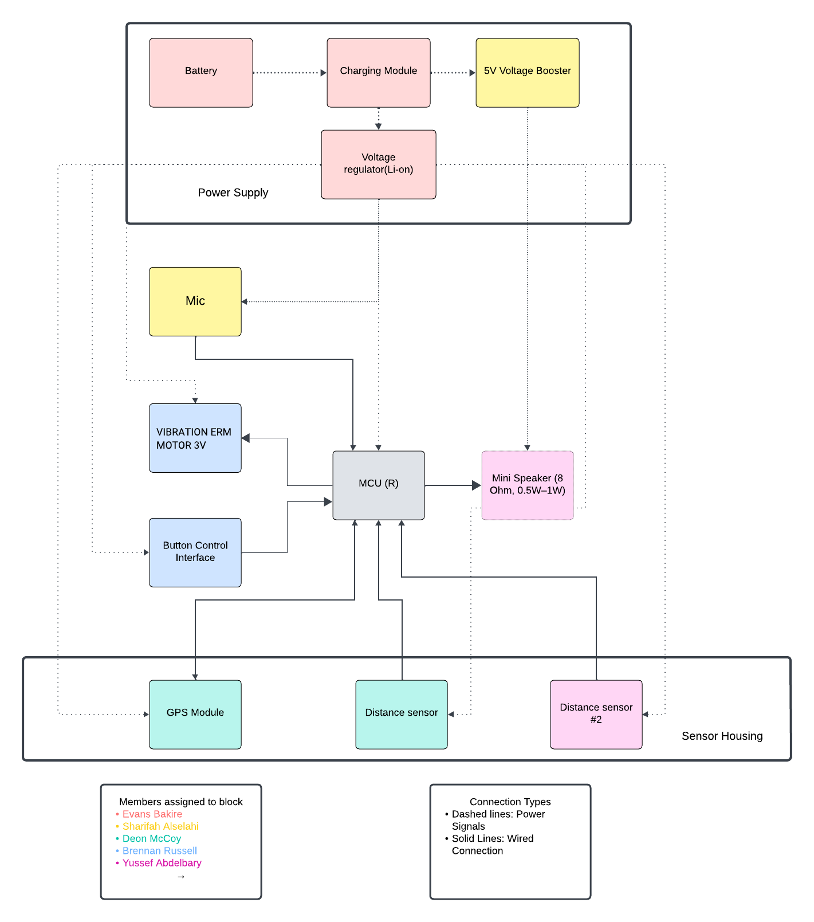
Hardware Block
Diagram

Slide 9
Our project requires precise object detection to achieve our goal of successful navigation for the visually impaired. Due to this, we decided the best route of action would be to include two sensors, one located at the top of the cane for ground level objects and another at the bottom for waist level objects.
After researching each technology, we concluded Time-of-Flight and Infrared sensing were the best options available.
Hardware Technology (Object Detection)
Parameters | ToF | Lidar | Ultrasonic | Photoelectric | mmWave | IR Distance
Principle | Light delay | Laser scan | Sound echo | IR reflect | EM reflect | Triangulation
Range | ~4m | 0.1–12m | 2cm–4m | 0–100m | 3–10m | 1–5m
Accuracy | High | Very High | Mod | High | High | Mod
Field of View | Var | Wide | Narrow | Var | Wide | Narrow
Robust | Good | Good | Good | Med | Med | Med
Cost | Med | High | Low | Med | High | Low
Power | Low | Med | Low | Low | Low | Low
Integration | Easy | Mod | Easy | Easy | Hard | Easy
Pros | Precise, fast | 3D mapping | Low cost; works in dark | Fast; versatile | Detects moving; wide cover | Effective for ground
Cons | Timing critical; range limited | Complex; costly | Noise sensitive; low res | Light dependent | Weather sensitive; complex | Limited range; narrow FoV

Slide 10
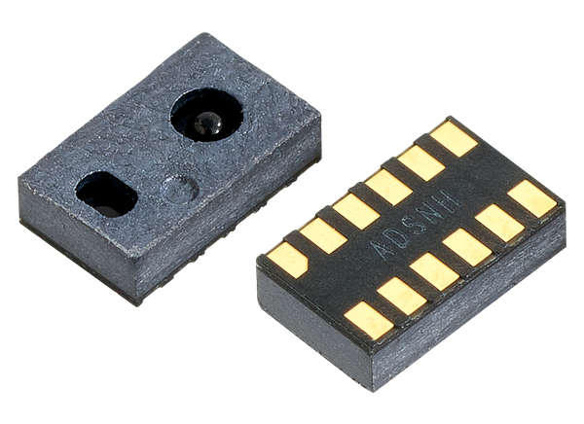
While researching various Time-of-Flight sensors for the bottom of the cane, we mainly considered the range, accuracy, and cost. These constraints were the most important factors to us to ensure we created a functional walking aid at a reasonable cost.
Hardware Component (ToF Sensor )
Parameter | VL53L1X | VL53L0X | VL6180X
Detection Range | Up to 4m | Up to 2m | Under 1m
Accuracy | Millimeter-level | Millimeter-level | Ultra-fast response
Field of View | Adjustable | Wide | Narrow
Power Consumption | Moderate | Low | Very Low
Price | Mod | Low | Low
Integration Complexity | Moderate | Low | Low
Response Time | Fast | Moderate | Very Fast
Operating Voltage | 3.3V | 3.3V | 3.3V
Interface | I2C | I2C | I2C

Slide 11
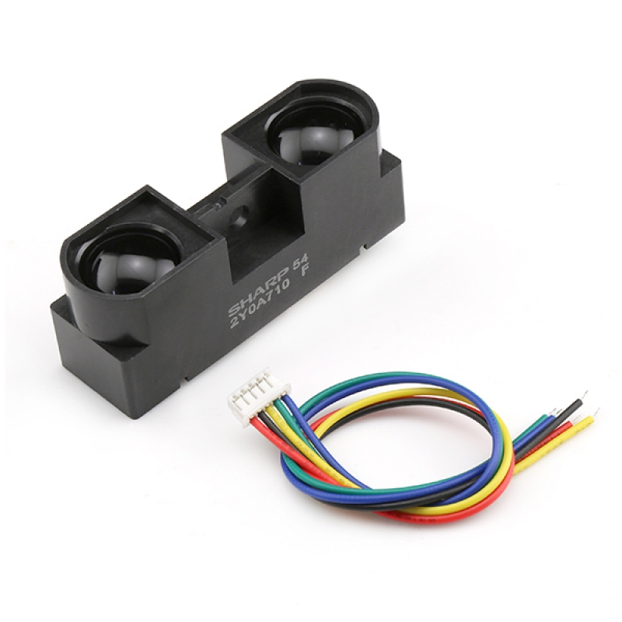
Similar to the research of the Time-of-Flight sensors, we analyzed the qualities of range, accuracy, and cost. In addition, we tailored the decision of this sensor to its position at the top of the cane.
Hardware Component (IR Sensor )
 | Sharp GP2Y0A710K0F | Sharp GP2Y0A21YK0F | Sharp GP2Y0A41SK0F
Range | 1 – 5.5 m | Up to 1m | Up to 4 m
Price | $12 | $5.65 | $8.18
Current Draw | Typ. 30 mA | 25 mA | 20 mA
Supply Voltage | 4.5 – 5.5 V | 4.5 – 5.5 V | 4.5 – 5.5 V
Footprint | 58 × 17.6 × 22.5 mm | 44.5 × 18.9 × 13.5 mm | 40 × 20 × 13.5 mm
Accuracy | High Accuracy | Moderate Accuracy | High Accuracy

Slide 12
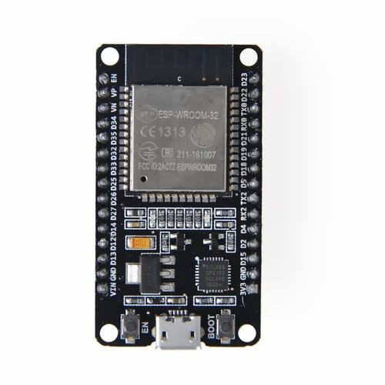
To determine the best microcontroller for our project, we compared the three listed in the table. Determining an appropriate MCU for our project was an important task. to ensure it would be capable of handling the scope of our project.
After evaluating these microcontrollers, we prioritized wireless connectivity, processing power, and I/O flexibility.
Hardware Component (MCU)
 | ESP 32 Wroom 32 | Arduino (ATmega328P) | MSP430FR6989
Processing Power | 240 Mhz | 18 Mhz | 16 MHz
RAM | 520 KB | 2KB | 120KB
WIFI Connectivity | Yes | No | No
Price | $6 | $3 | $4
GPIO Pins | 36 Gpio pins | 23 GPIO Pins | 83 GPIO Pins
Cores | Dual Core | Single Core | Single Core
Bluetooth Connectivity | Yes | No | No

Slide 13
Our project requires a microphone to allow users to directly interact with the cane through speech. We wanted to find a technology that would be easy to integrate, but would effectively capture sound in various environments while consuming little power.
Due to these reasons, we determined digital MEMS microphones would best suit our project.
Hardware Technology (MEMS Microphones)
Parameter | Digital MEMS Microphones | Analog MEMS Microphones | Electret Condenser Microphones
Operating Principle | Capacitive, I²S | Capacitive, Analog | Electric, Analog
Signal Output | Digital (I²S) | Analog | Analog
Frequency Range (Hz) | 20-20k | 20-20k | 20-20k
Power Consumption | ~0.5 mA | ~1 mA | ~1 mA+
Size | ~3×3×1 mm | ~3×3×1 mm | Larger
Integration Complexity | Low | Moderate | High
Noise Performance | Low | Moderate | Moderate
Sensitivity | ~60-65 dB | ~60-65 dB | ~55-60 dB

Slide 14
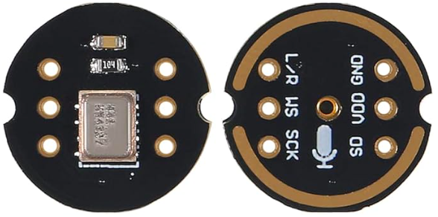
Although most of the microphone components we researched had similar qualities, we ultimately decided on the INMP441. It provides adequate performance with easy integration into our project.
Hardware Component (MEMS Microphones)
 | INMP441 | SPH0645LM4H‑B | ICS‑43434
Frequency Response (Hz) | 20Hz - 20kHz | 20Hz - 20kHz | 20Hz - 20kHz
Signal-to-Noise Ratio (dB) | 60 dB | 65 dB | 60 dB
Operating Voltage (V) | 3.3 V | 1.8 - 3.3 V | 1.8 - 3.3 V
Price | $3 | $2.5 | $2
Max Sample Rate | 96 kHz | 48 kHz | 96 kHz
Package (mm) | 3 × 4 × 1 | 3 × 3 × 0.95 | 3.5 × 2.65 × 0.98

Slide 15

GPS Modules Comparisons
Parameter | NEO-M9N-00B | Neo-F10N-00B | ZED-F9P-05B | NEO-6M
Accuracy (CEP) Best (Assisted) | 2.0m 2.0m | 1.0m 1.0m | 1.5m 0.01m | <2.5m <2.0m
Multi-GNSS | GPS, GLONASS, Galileo, BeiDou | GPS, Galileo, BeiDou | GPS, GLONASS, Galileo, BeiDou | GPS
Max Update Rate | 25 Hz | 20 Hz | 18 Hz | 5 Hz
Power Consumption (Average) | 28mA Acquisit. 19mA Tracking | 26mA Acquisit. 27mA Tracking | 75mA Acquisit. 70 mA Tracking | 47mA Acquisit. 39mA Tracking
Voltage | 2.7 - 3.6 V | 2.7 - 3.6 V | 2.7 - 3.6 V | 3.1 - 5.5 V
Protocols Supported | UBX, NMEA 4.10, RTCM 3.3 | UBX, NMEA 4.11 | UBX, NMEA 4.11, RTCM 3.4, SPARTN 2.0.1 | UBX, NMEA 3.0
Communication INT. | UART, SPI, I2C USB | UART | UART, SPI, I2C USB | UART, USB, SPI, DDC
Dimensions(mm) | 16.0x12.2x2.4 | 16.0x12.2x2.4 | 21.8x16.8x2.2 | 16x12.2x2.4
Weight | 1.6g | 1.0g | 1.8g | 1.6g
Price (USD) Breakout Board | $27 $74.95 | $49 $39.95 | $129 249.95 | $6.75 $9.00
Accuracy
Update Rate
Low Power Consumption
Cost

Slide 16
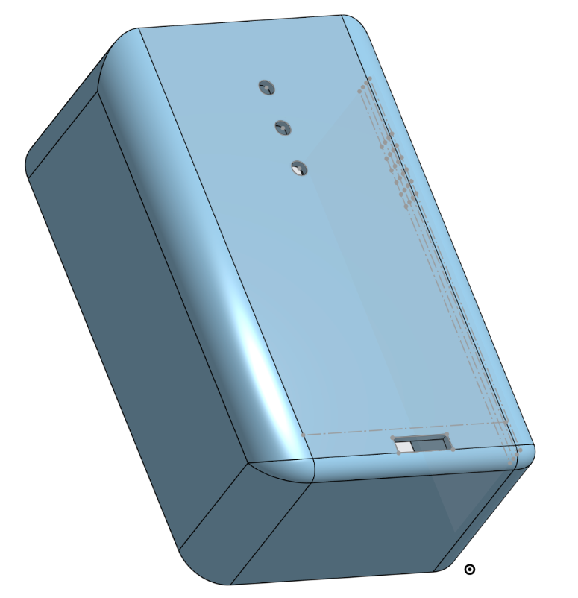
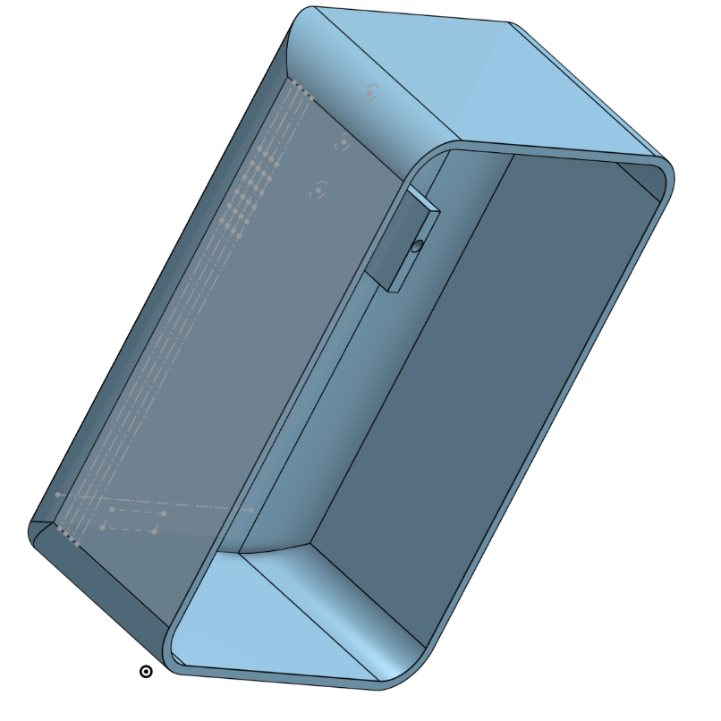
Single 3D-printed enclosure housing all SmartNav components
Top-mounted sensors and microphone integrated into the lid
Dedicated ports for audio output and power connections
Modular compartments for PCBs and power supply for precise fit
Fully protects all electronics within a unified housing
3D-Printed Housing Design Concept

Slide 17
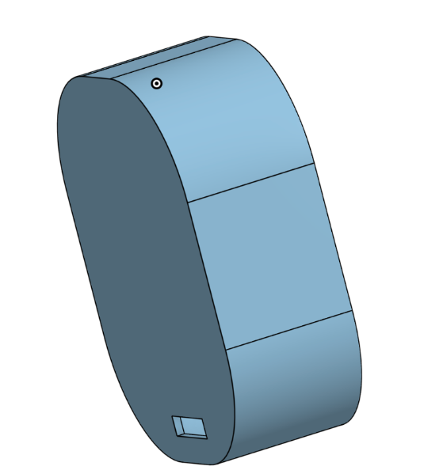
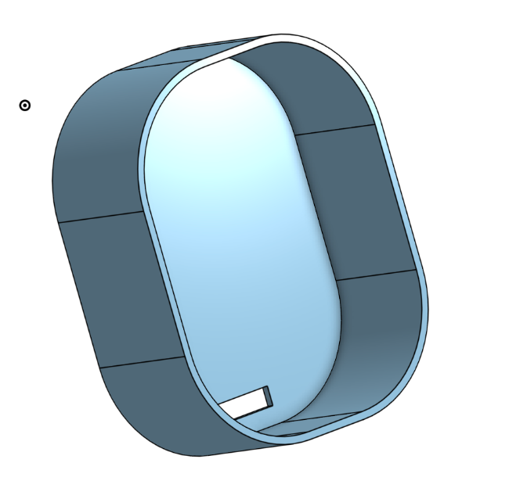
3D-Printed Housing Design Concept (Bottom Sensor Housing)

Slide 18
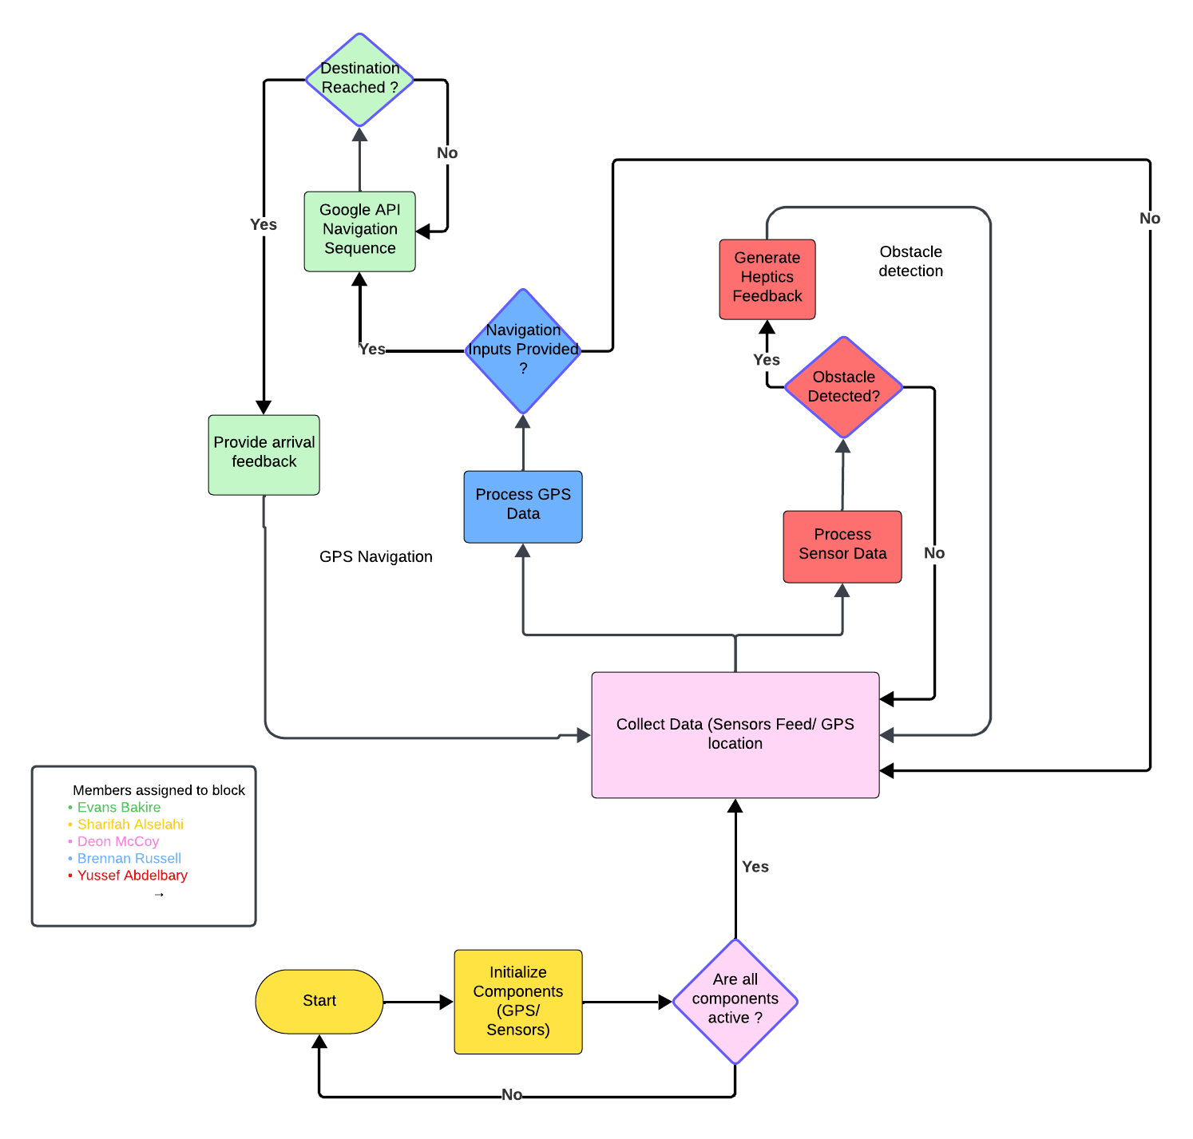
Software Flow
Chart

Slide 19
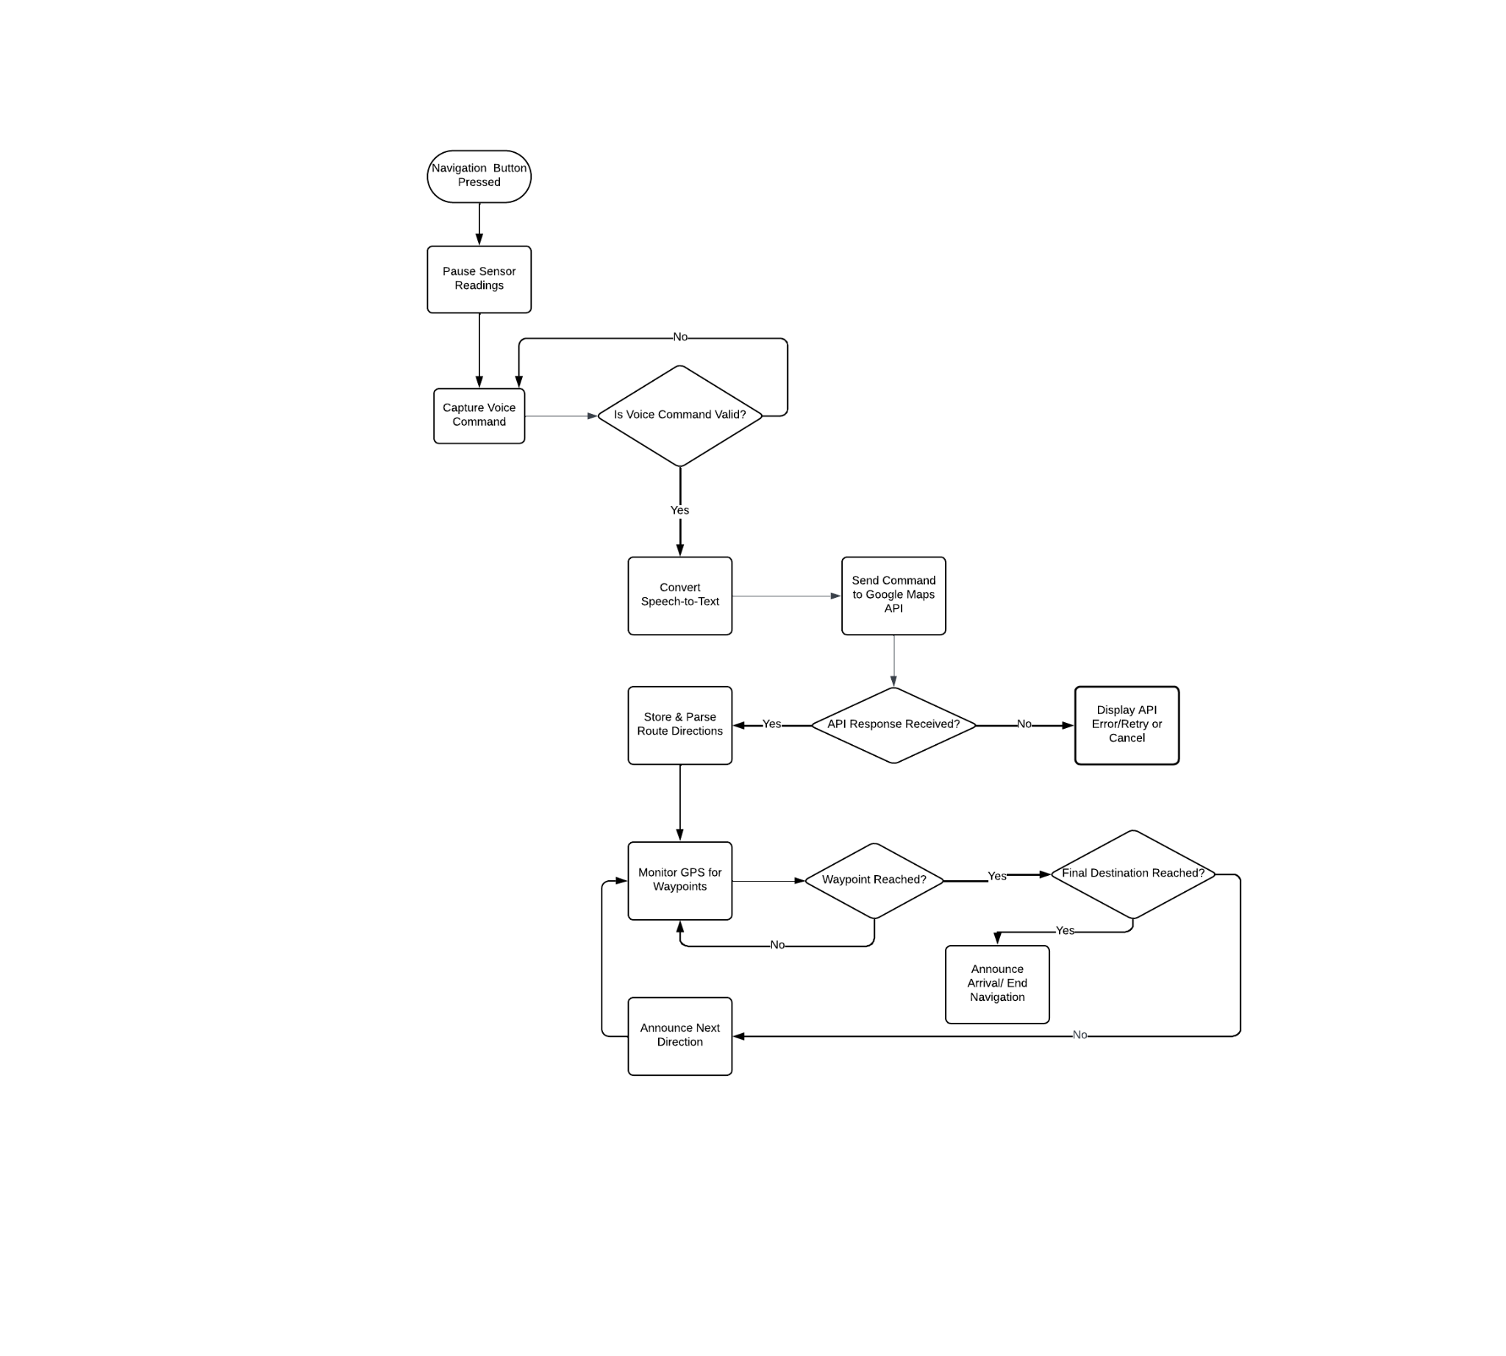
Navigation System
Flowchart

Slide 20
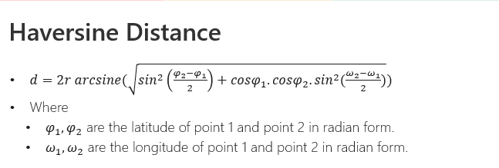
Software Design (Way point Distance)
Treat each waypoint’s latitude/longitude as points on a sphere and apply the Haversine formula to compute their distance.
Use that calculated distance to determine proximity, compare waypoints, or trigger navigation events when the user approaches a waypoint.
If d ≤ 10 m (prepare zone): Generate/load the spoken prompt onto the SD card
if d ≤ 5 m (trigger zone): Play the pre‐loaded “turn now” audio so it’s heard exactly when the user reaches the waypoint.

Slide 21
Software Design (API)
Navigation API
  Google Maps Directions API ( Widely used, high coverage and accuracy Simple JSON “steps” output.Familiar SDKs )
Speech-to-Text
  Google Cloud Speech-to-Text ( Best accuracy for English walking commands, Streaming & batch modes, Consistent API family)
Text to Speech
  Deepgram Text to Speech (ext-to-Speech , Streams audio in small chunks, fitting within our buffer constraints, Avoids large base64 JSON payloads that Google TTS returns)

Slide 22
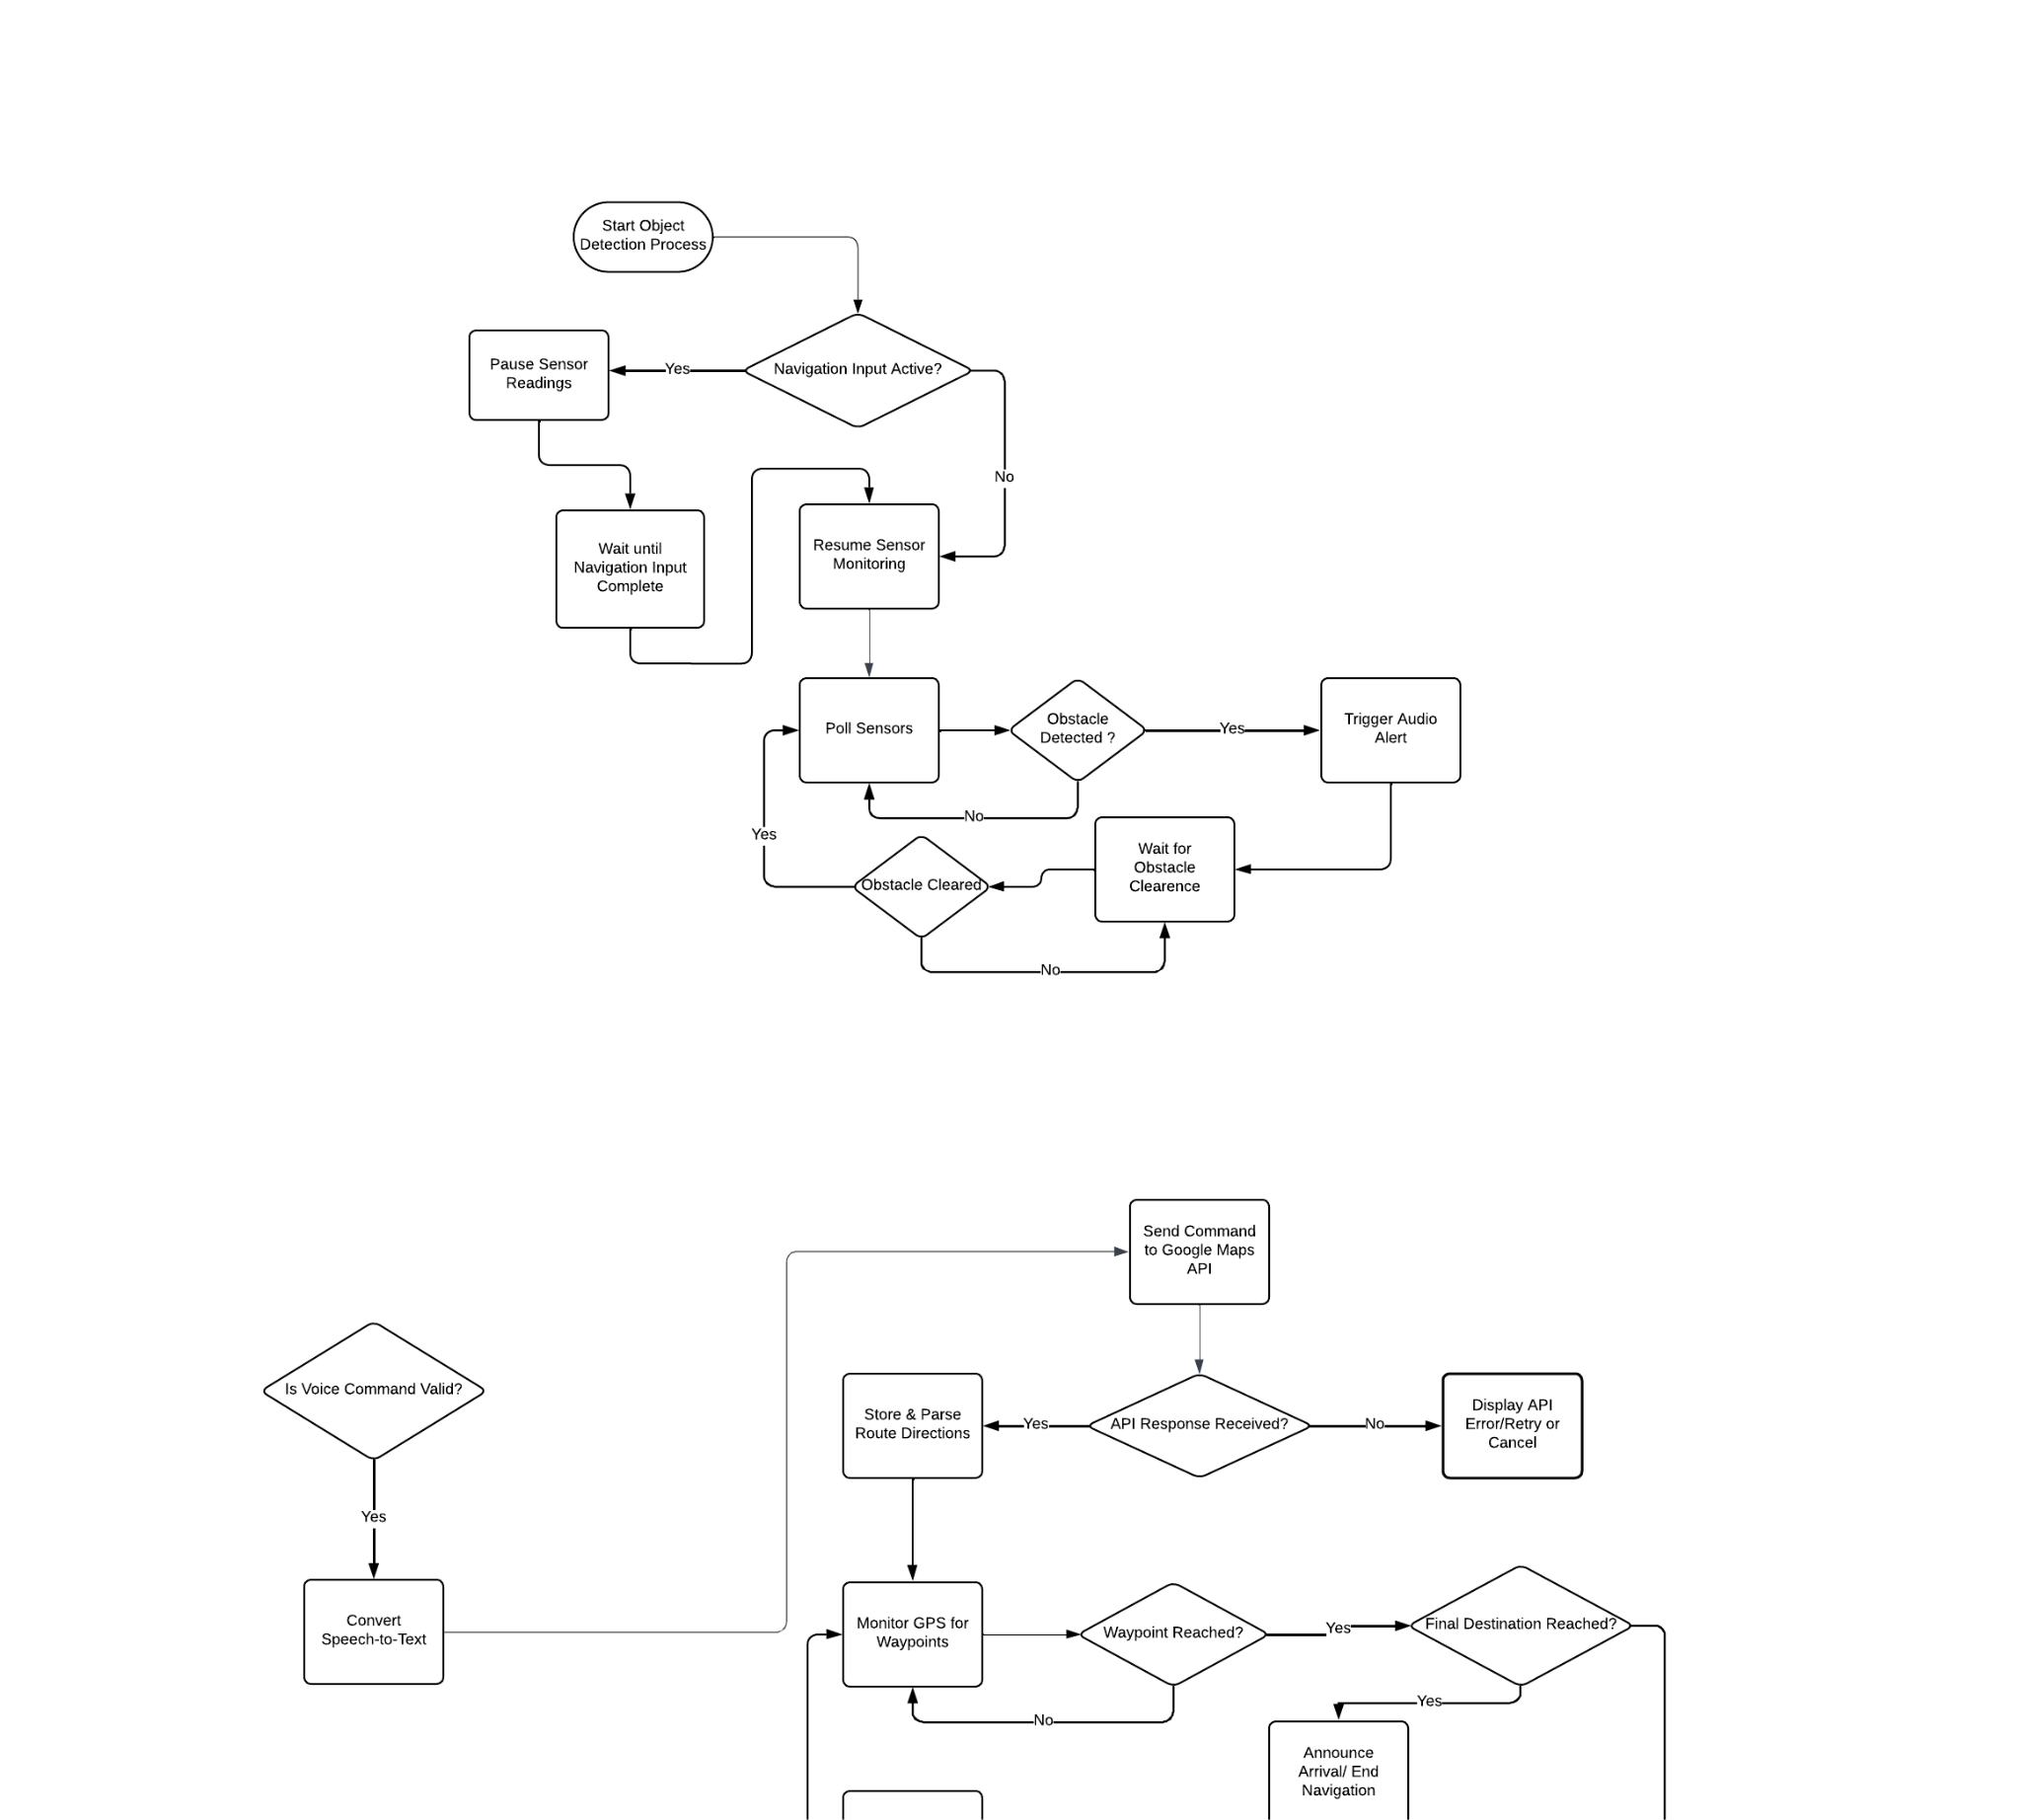
Object Detection System
Flowchart

Slide 23
Development Environment Comparisons
 | Arduino-IDE | PlatformIO | ESP-IDF
Language Support | C/C++ | C/C++, Python | C/C++, Python, Rust
Board Support | Arduino and ESP32 | Various platforms and frameworks | ESP framework
Debugging | Limited(serial monitor) | Advanced(JTAG, GDB) | FULL
Compiler | Moderate | Moderate | Optimized
Use case | Beginners/ user-friendly | Intermediate, advanced features | Experts/steep learning curve/performance-critical apps
User Friendly
Existing Libraries
Large Community

Slide 24
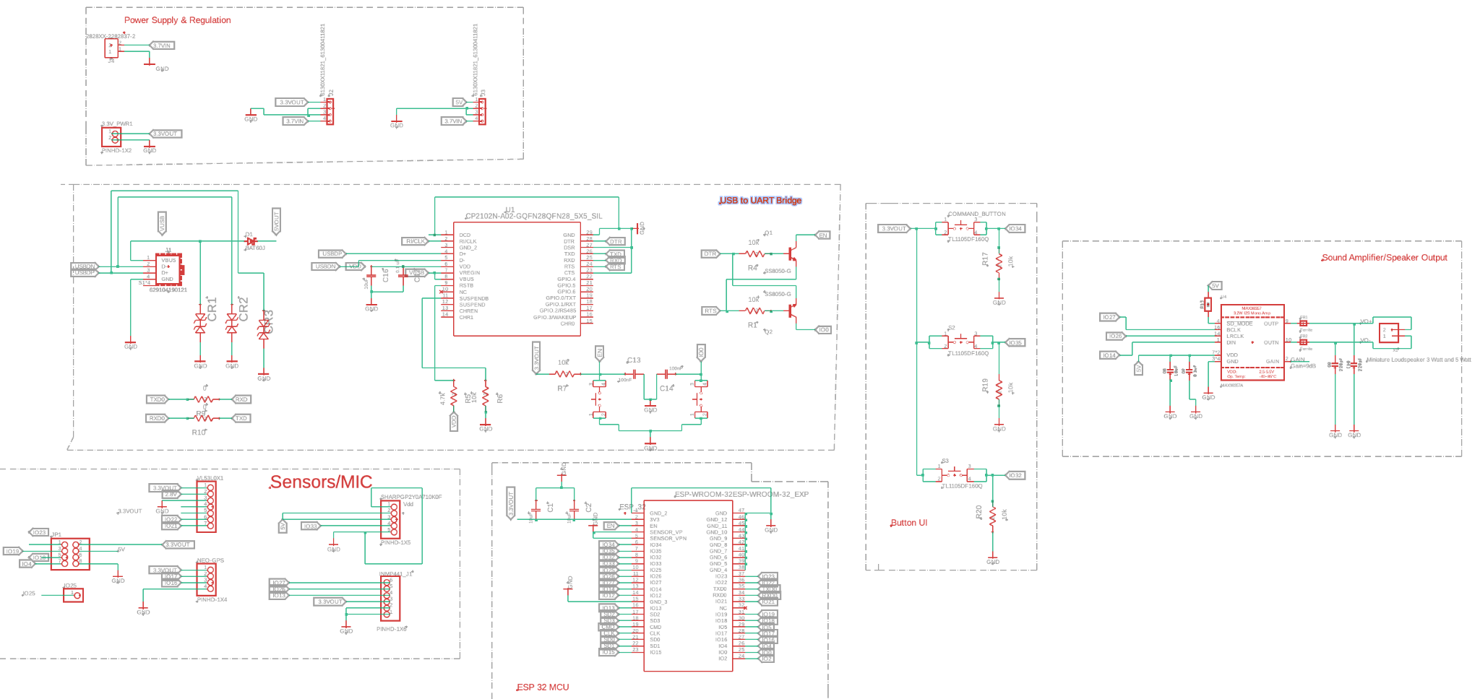
PCB (MCU Layout Schematic )

Slide 25
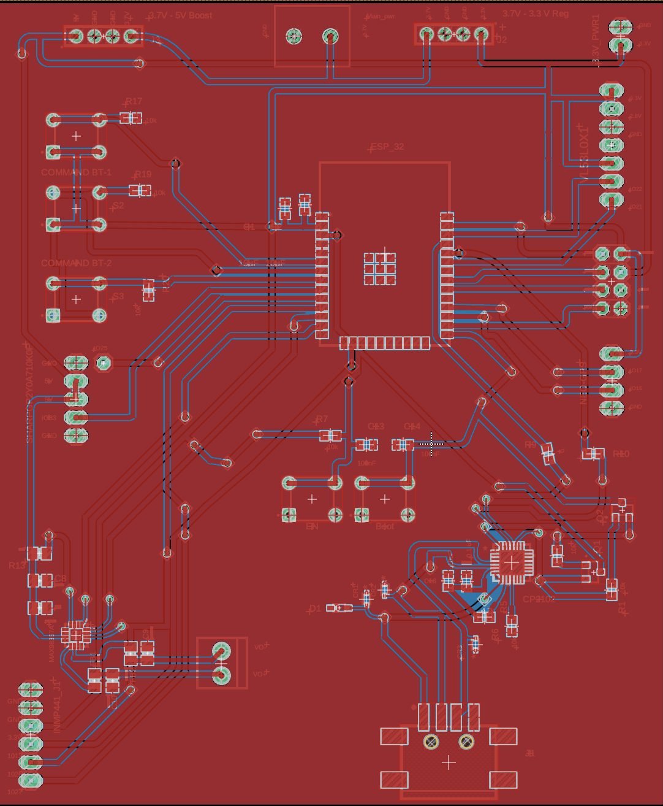
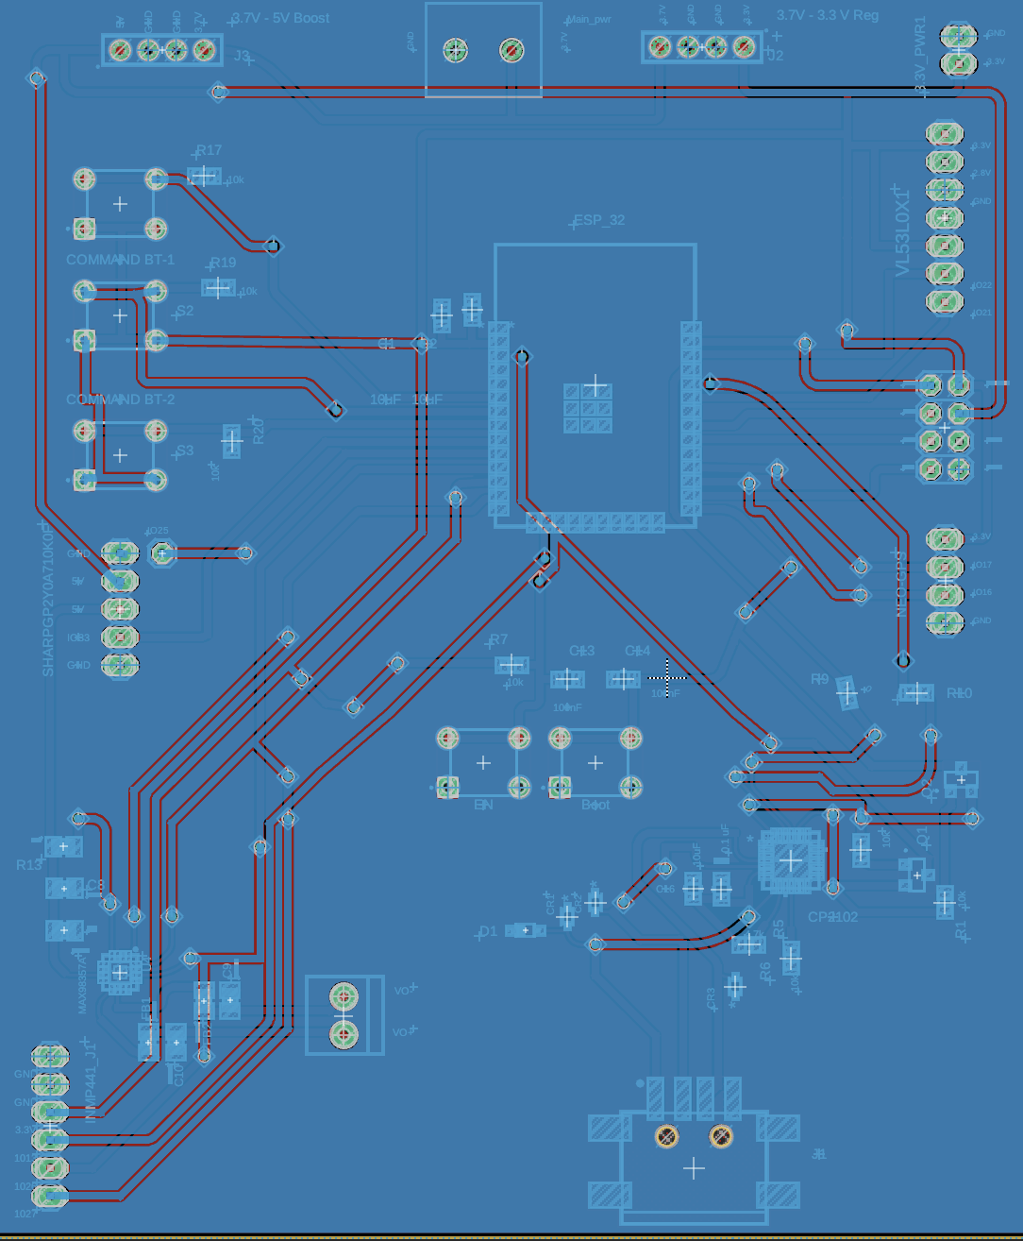
PCB (MCU Layout)

Slide 26
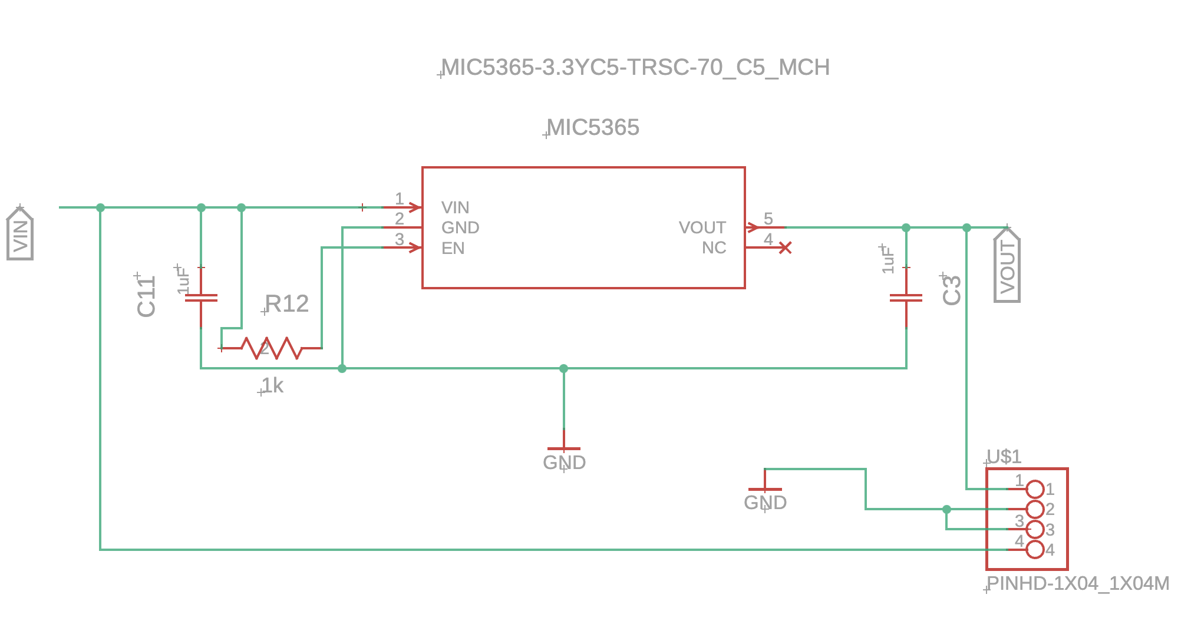
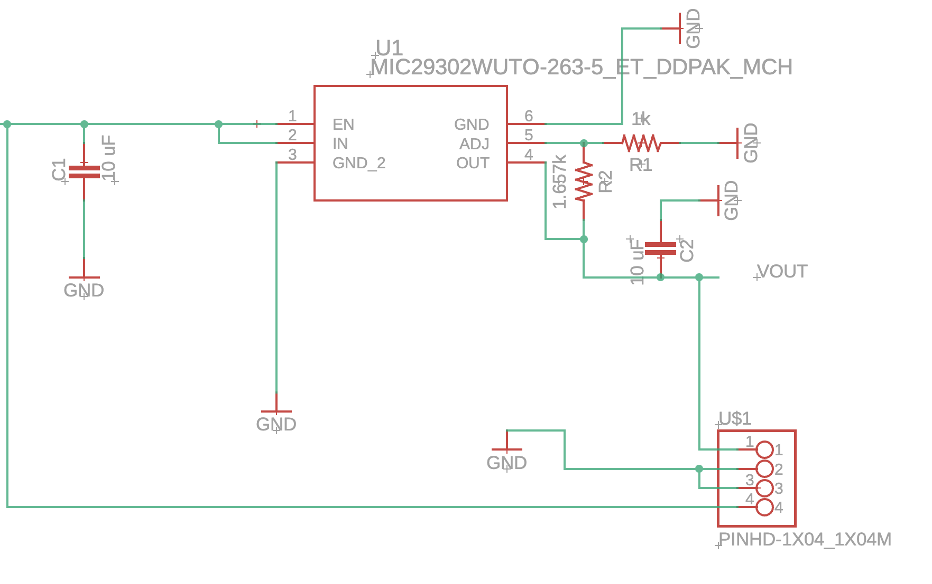
PCB (3.3 V Reg #1&2 Schematics )

Slide 27
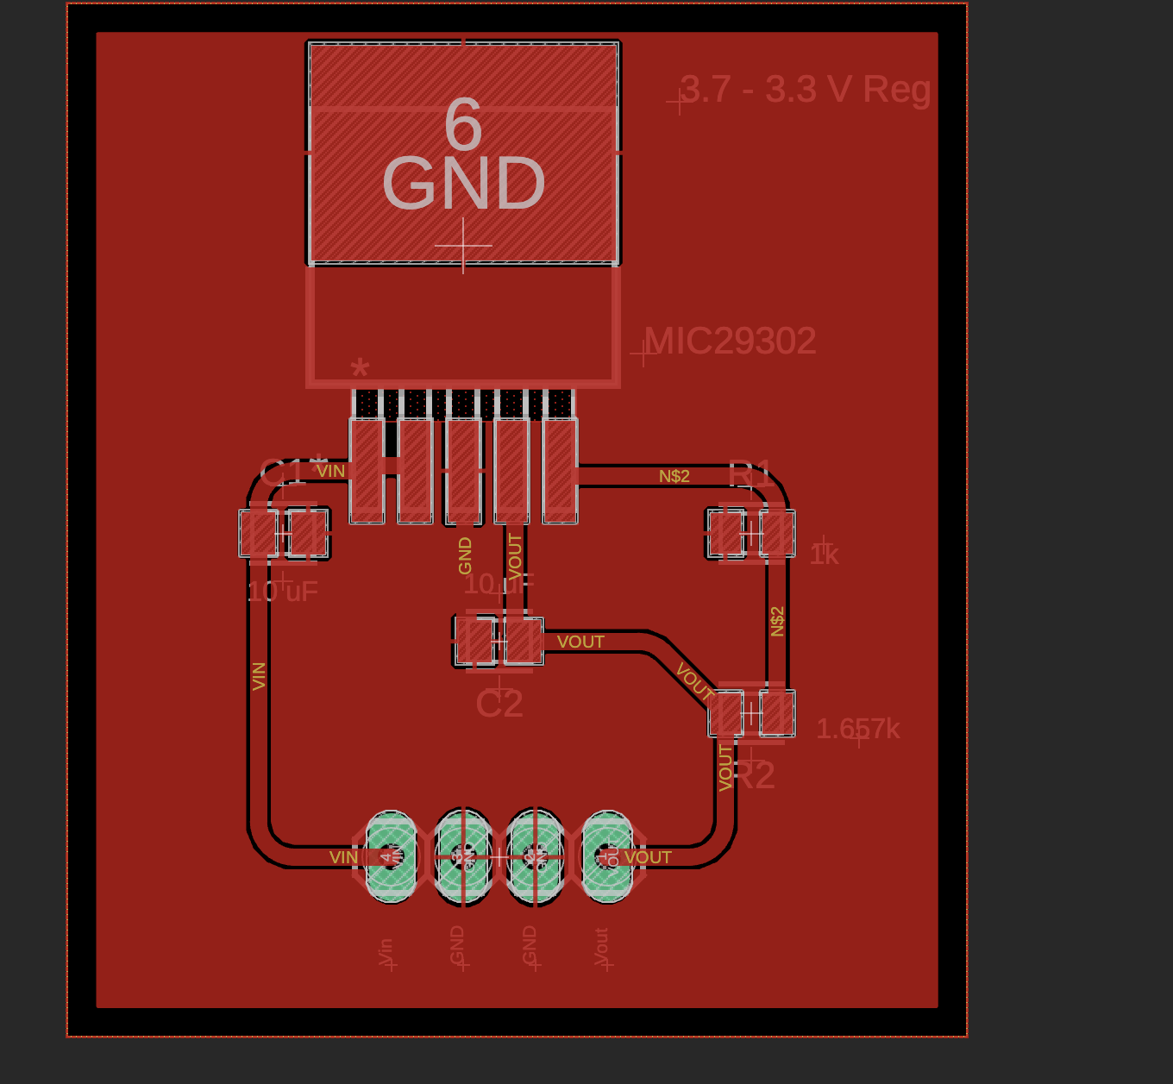
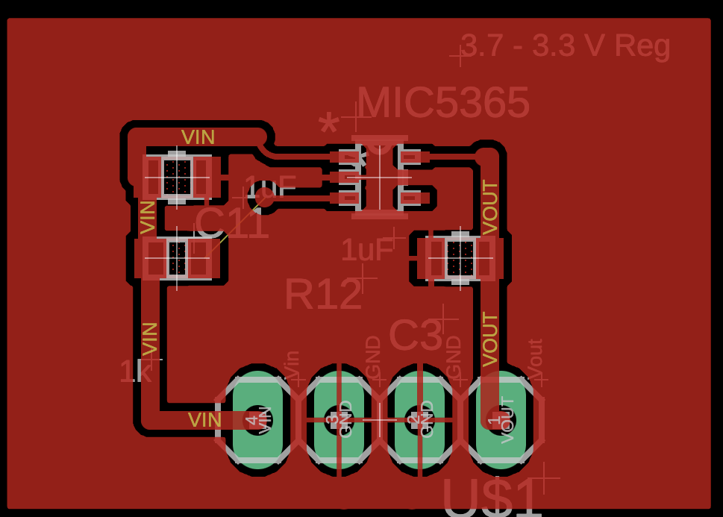
PCB (3.3 V Reg #1 & 2)

Slide 28
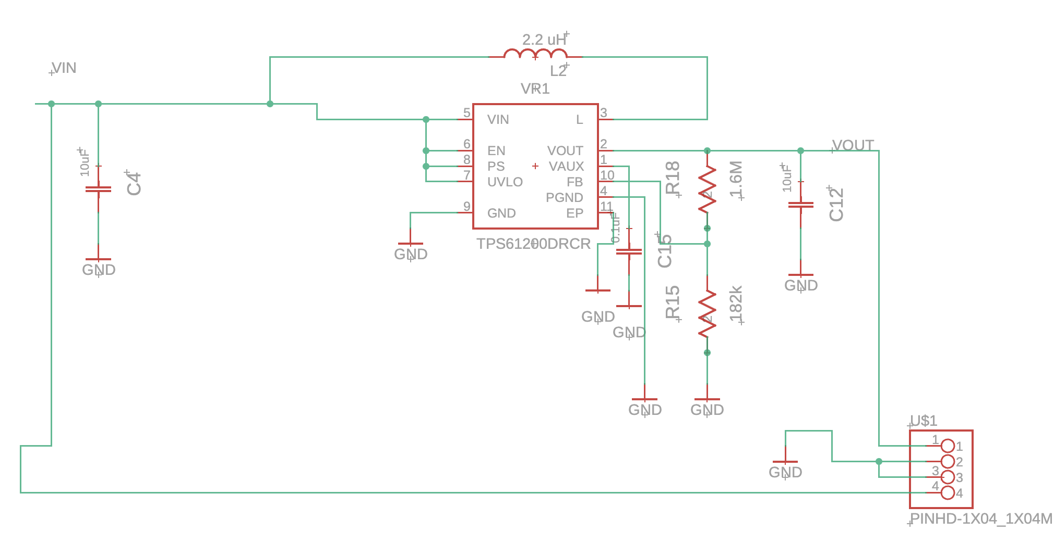
PCB (TPS 3.7 - 5V Boost Schematic )

Slide 29
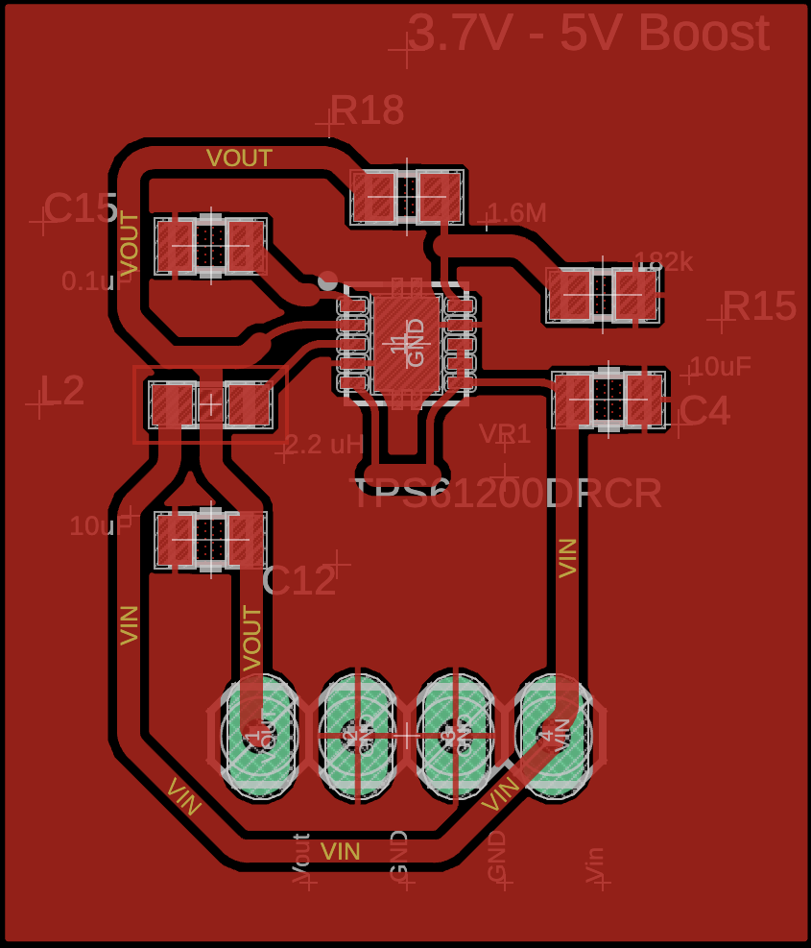
PCB (TPS 3.7 - 5V Boost )

Slide 30
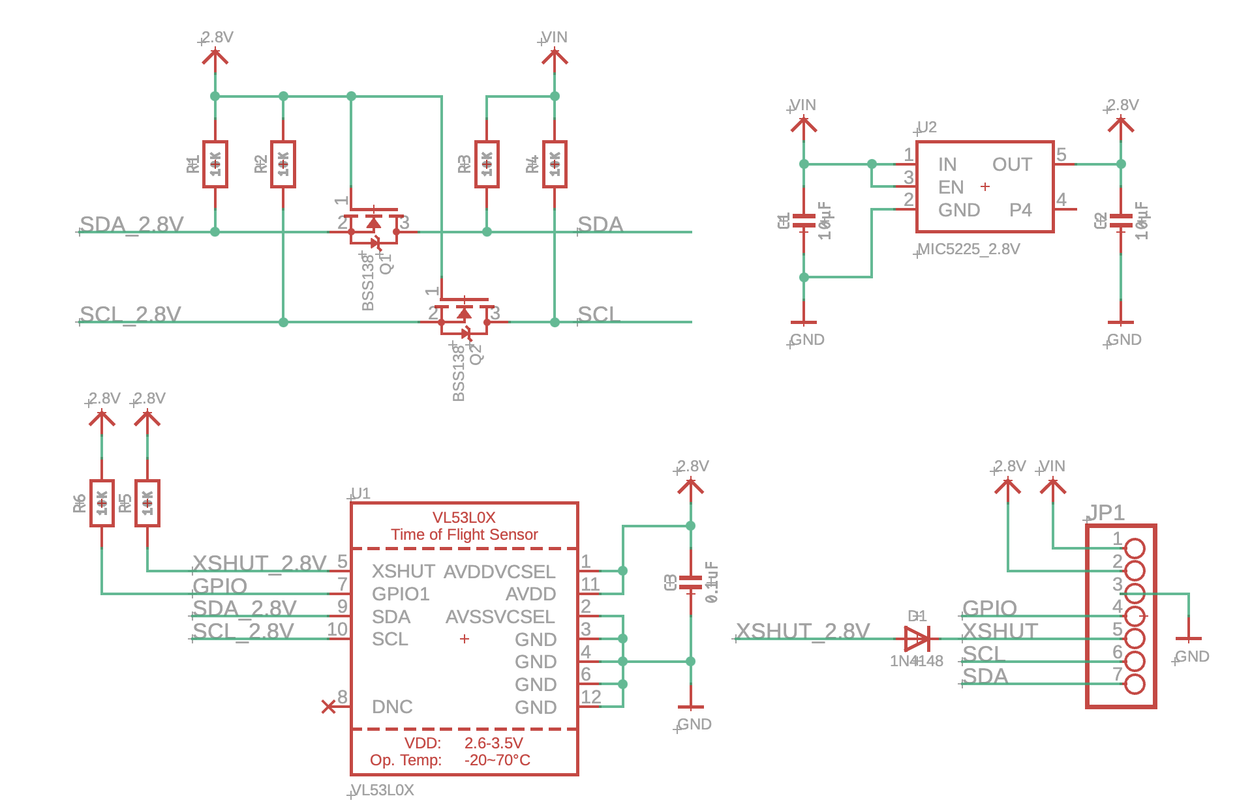
PCB (VL53L1X Sensor Schematic)

Slide 31
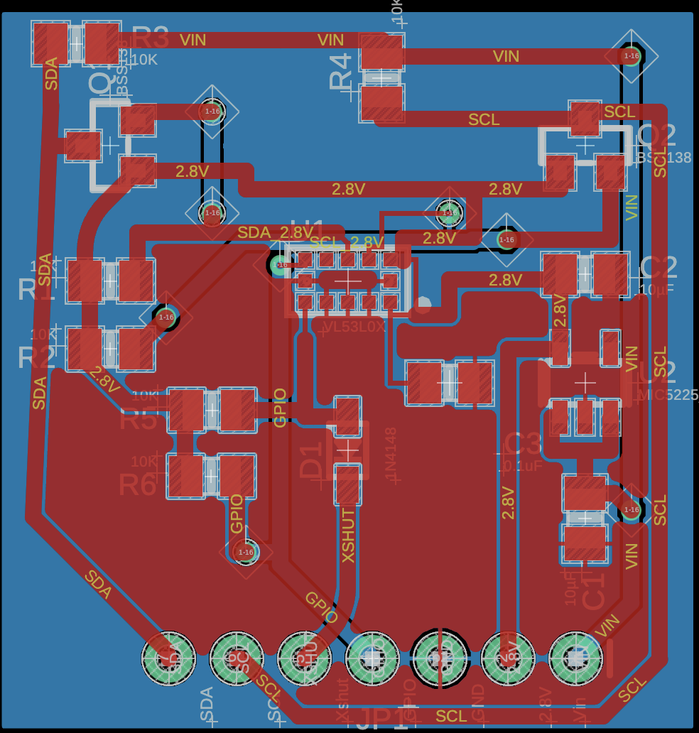
PCB (VL53L1X Sensor)

Slide 32
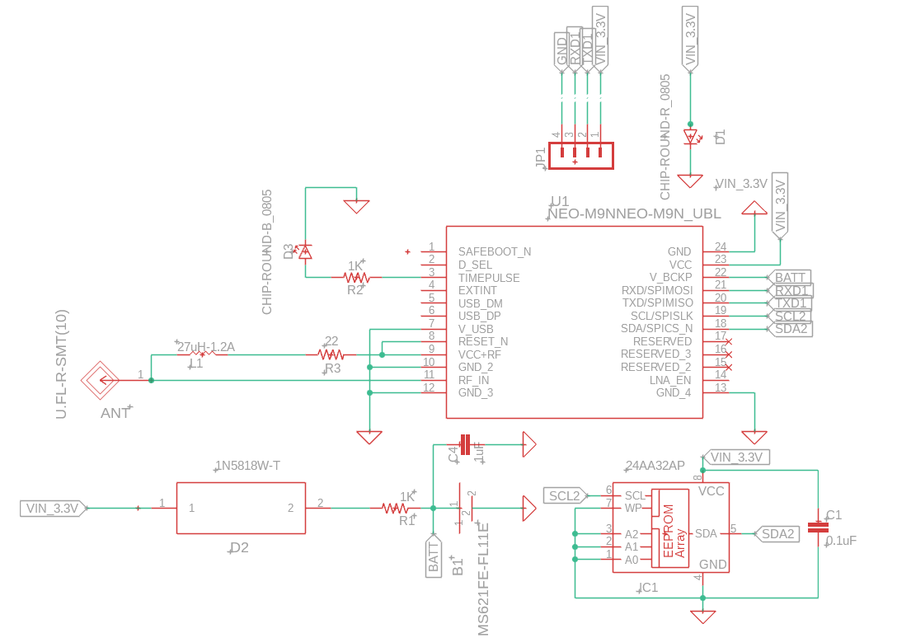
PCB (GPS Module Schematic)

Slide 33
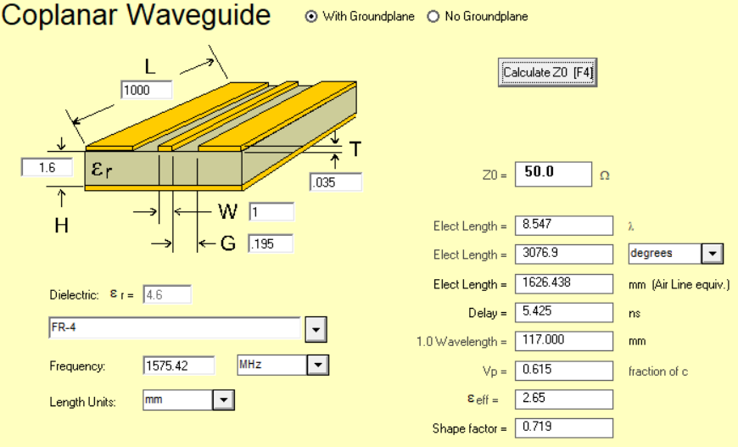
GPS Module Design Considerations
AppCad

Slide 34
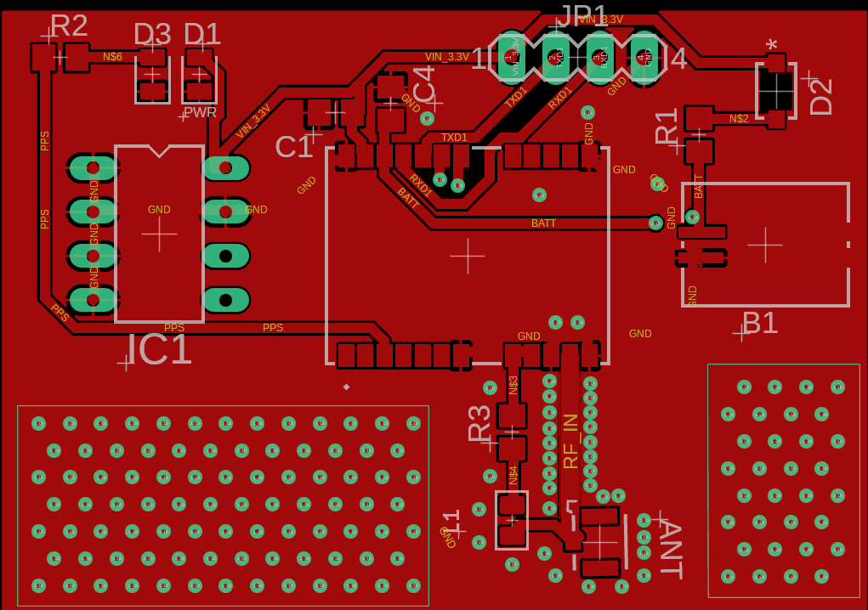
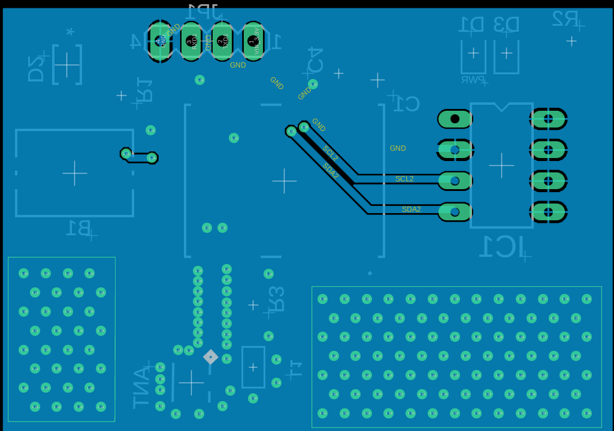
PCB (GPS Module)

Slide 35
Prototyping and Testing
Breadboard Hardware Validation:
  Prototype ESP32, INMP441 microphone, MAX98357A amplifier, and SD card on a development board
  Verify I²S data paths for audio input/output before PCB design
API Functionality Verification:
  Test HTTP requests to Deepgram (STT/TTS) and Google Directions endpoints from prototype
  Monitor JSON parsing, base64 decoding, and audio buffer handling under real-world conditions
Sensor Integration Tests:
  Confirm accurate GPS coordinate acquisition and sensor data communication via I²C/SPI
  Connect GPS module, accelerometer, and other peripherals to the MCU PCB

Slide 36
Performance Evaluation
Data Collection:
  GPS accuracy: within 2.5m (goal ≤3m).
  Detection: 90%+ accuracy for low/high obstacles.
  Power: ~4.6W average usage.
Navigation Accuracy:
  Compare calculated routes versus actual walked paths
  Measure deviation between suggested waypoints and user’s real-world position
I²S Audio Quality
  Evaluate clarity of microphone input (INMP441) and speaker output (MAX98357A)
  Measure signal-to-noise ratio and intelligibility in typical environments

Slide 37
Problems and Solutions
ESP 32 RAM Overload from TTS/STT Streams
  Google’s STT and TTS APIs require large in-memory buffers for PCM decoding and JSON parsing, quickly exhausting the ESP32’s ~520 KB of usable RAM.
  Resulted in heap fragmentation, buffer overflows, and frequent crashes
Unstable 3.7 V → 3.3 V Regulation
  LDO regulators could not maintain 3.3 V under Wi-Fi + audio peaks (≈500 mA), leading to thermal shutdown or dropout.
  Switching regulators introduced excessive noise or drew high quiescent current, causing ESP32 brown-outs and peripheral failures.

Slide 38
Success
Successfully implemented end to end API pipeline on ESP 32 from audio input to spoken navigation
  Integrated Speech to text from Google Cloud API, and retrieved step by step walking routes, converted these instructions to Speech again utilizing Deepgram’s TTS API
Configured 12S interface to capture audio from our INMP4441 Mems mic and output raw PCM to MAX98357A A amplifier and speakers, enabling audio input to output functionality
GPS module prototype was successful

Slide 39
Plan for completion
Finalize and 3d print the sensor and Component housing
Construct and fully test all PCB’s
Incorporate Sensors and other Peripherals to the MCU PCB
Testing and verify that voice commands picked up by the INMP4441 mic trigger navigation routines and produce audio prompts via the MAX98357A amp and speakers
Implement the GPS module PCB to send real coordinates to the navigation system

Slide 40
All of the essential parts and components required for the construction of the SmartNav mobility stick with a total of $280 usd
Bill of materials
Component | Price | Quantity
PCB Board Orders | $ 150 | 5 Boards
PCB Components | $ 65
TP4056 charging module | $ 2 | 1
Regulators 3.3V | $ 6 | 2
Li-io Rechargeable Battery | $ 10 | 1
PUI Audio 3W 4Ω Mini Loudspeaker | $ 7 | 2
I2S Amplifier Module | $2 | 1
ESP 32 Wroom 32 | $5 | 1
Visually Impaired Assistive Cane | $12 | 1
GPS Module + Antenna | $9
Object Detection Sensor #1 & #2 | $12 | 2

Slide 41
Work Distribution
Evans Bakire | Deon McCoy | Sharifah Alselahi | Brennan Russell | Yussef Abdelbary
MCU PCB Design Regulators PCB Design Speech to Text & Text to Speech Api testing and integration | GPS Module PCB Design GPS Module Software Integration | Route Navigation API Implementation Sound system testing | ToF Sensor PCB Design Sensor Software Implementation and testing | Smartnav Housing 3d Design IR sensor Software testing and integration

Slide 42
Thank you! We’re happy to take questions.

